Slide 1
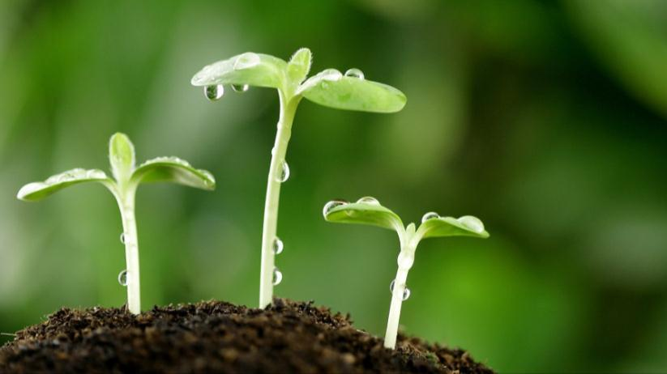
Green BRI and NGOs
Chen Taiyong
Executive Director of Sichuan Haihui Poverty Alleviation Center
January 25, 2022

Slide 2
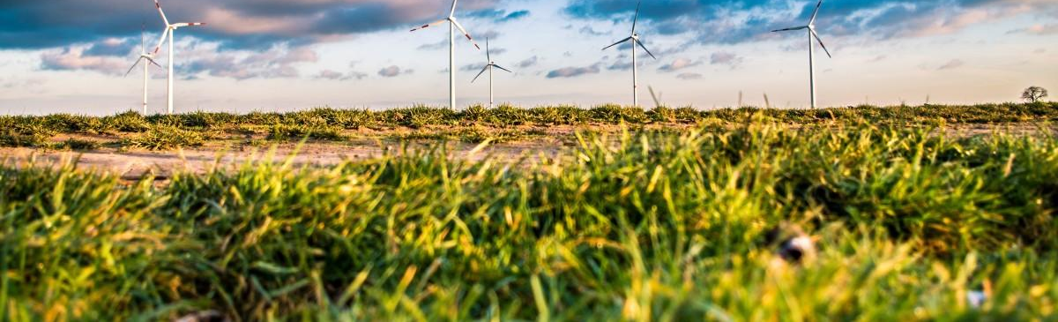
The Green BRI
“We should promote ecological progress in conducting investment and trade, increase cooperation in conserving eco-environment, protecting biodiversity, and tackling climate change, and join hands to make the Silk Road an environment-friendly one ... We support localized operation and management of Chinese companies to boost the local economy, increase local employment, improve local livelihood, and take social responsibilities in protecting local biodiversity and eco-environment.”
“Vision and Actions on Jointly Building Silk Road Economic Belt and 21st-Century Maritime Silk Road.” jointly issued by the National Development and Reform Commission, Ministry of Foreign Affairs and the Ministry of Commerce of PRC, 2015

Slide 3
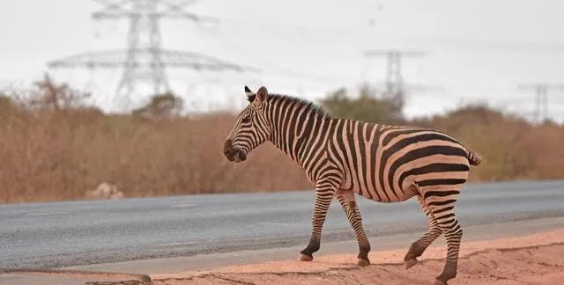
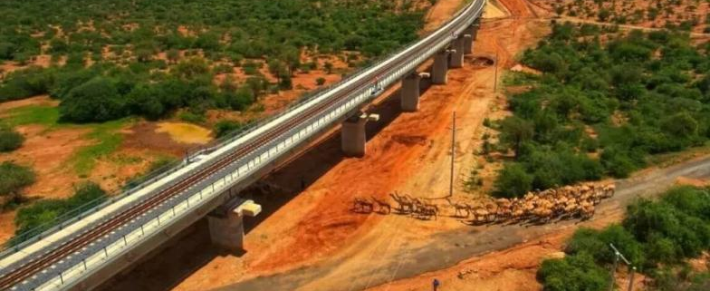
Some progress has been made
Nairobi–Malaba Standard Gauge Railway – China Railway Construction
the construction work was divided into several stages with land reclamation along the way → keep the original land and plants intact
a 6.5km-long bridge traversing the park with the shortest pier being 7.5m and the tallest 41.5m → ensure free passage of wildlife, especially giraffes and other large animals
utilized machine-made sand made of local igneous rock to replace traditional “river sand” → protect the local rivers

Slide 4
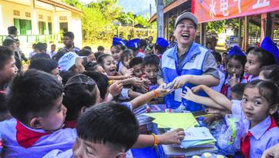
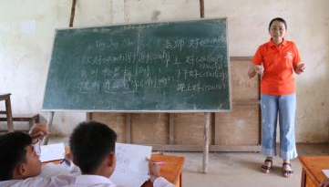
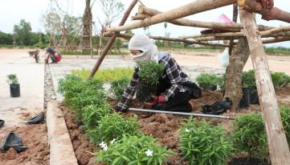
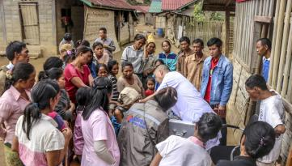
Some progress has been made
China-Laos Railway (Boten–Vientiane railway)-Power China
A green railway - planted various kinds of vegetation such as winter jasmine and tea trees on roadbeds and tunnel slopes; each station has been designed with plenty of space for all kinds of flora to ensure harmony between the greening of a new building and the local scenery
More than a construction project - provide medical services to local people and train local medical workers; recruit volunteers to teach at local schools and donate school supplies; construction of drinking water project for residents

Slide 5
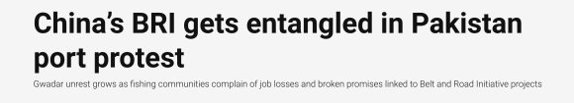
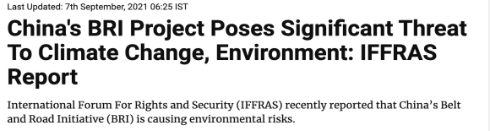

But also some criticism…..

Slide 6
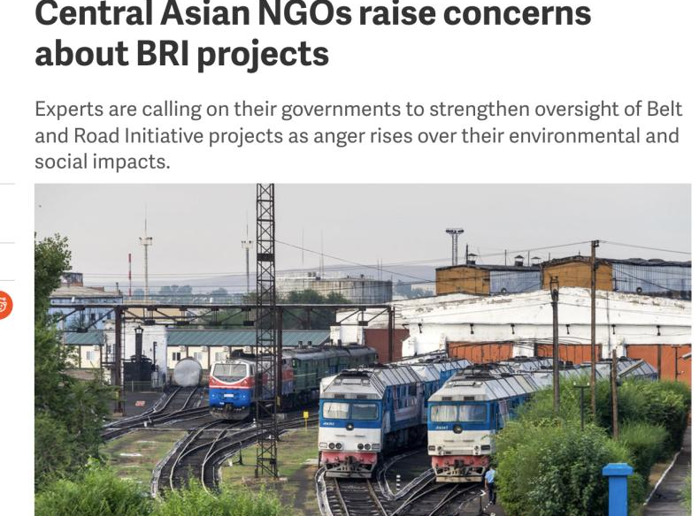

Slide 7
Possible factors contributing to the disagreement
Insufficient stakeholders engagement in project development, implementation and impact assessment
Ineffective information reporting and disclosure
Improvement on the environmental and social management system of the projects

Slide 8
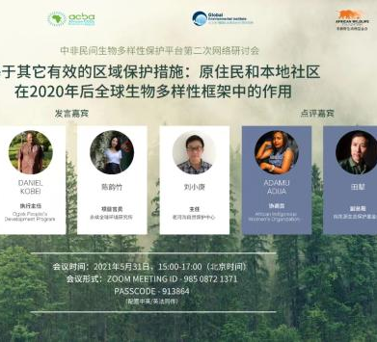
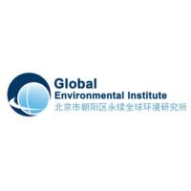

Roles of NGO in the Green BRI
Facilitate dialogues and the establishment of communication channels with local government, communities, social organizations and residents
Organized capacity-building training for Chinese firms to strengthen their capacity for responsible and green investment
Global Environmental Institute（GEI), a Haihui’s NGO partner, organized dialogues between local civil society organizations in the Republic of Cameroon and the Republic of the Congo and Chinese companies working in these countries

Slide 9
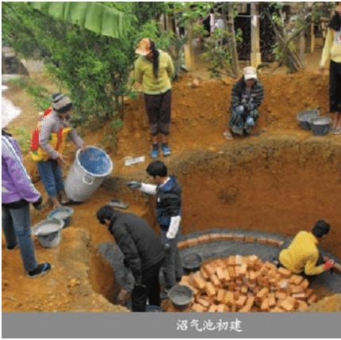
What more can be done - GEI
GEI worked with China Water Resources and Hydropower Construction Group to develop programs promoting biogas technology in Laos for energy production and agriculture
NGOs have extensive experience in implementing community and environmental management projects
Promoting sustainable livelihoods in BRI countries with Chinese companies

Slide 10
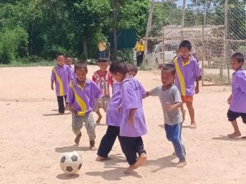
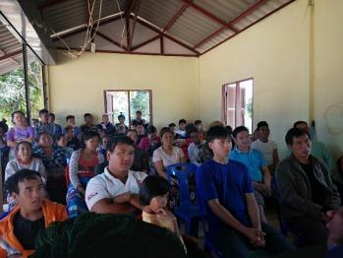
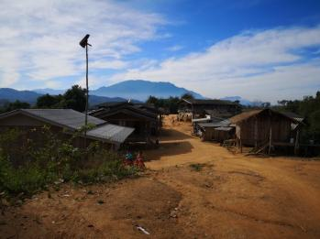
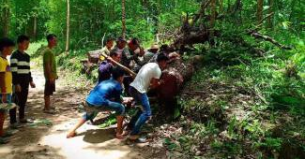
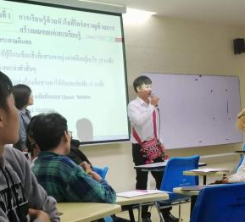
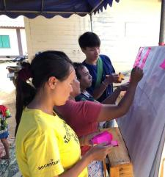
What more can be done-Haihui
Haihui’s community development project in Northern Thailand
Rural teacher plan
Help women and youth development
Carry out projects to promote sustainable development in BRI countries with Chinese firms

Slide 11
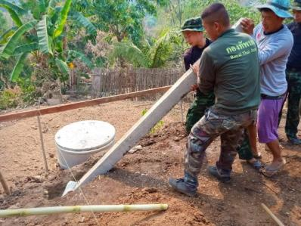
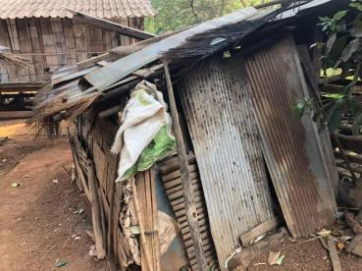
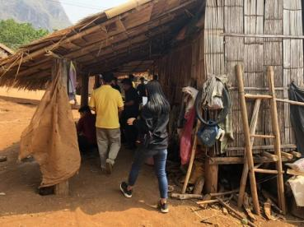
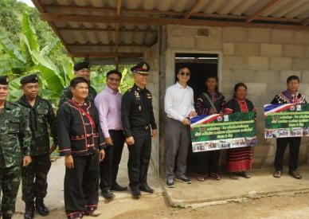
Chinese NGOs are “going global”
Haihui’s Hilltribe Sanitary Toilet Building project in Thailand
Lahu & Ahka Communities
4 counties in Chiang Mai, Chiang Rai in northern Thailand
28 toilets built
140 households co-built, co-sharing, co-management

Slide 12

More partnership is needed
Partnership between NGOs and Chinese firms
Partnership between Chinese NGOs and local NGOs in BRI countries

Slide 13


Also, more patience and understanding are needed from international communities

Slide 14

Thank you very much!
And your questions and comments are welcomed!

