Slide 1
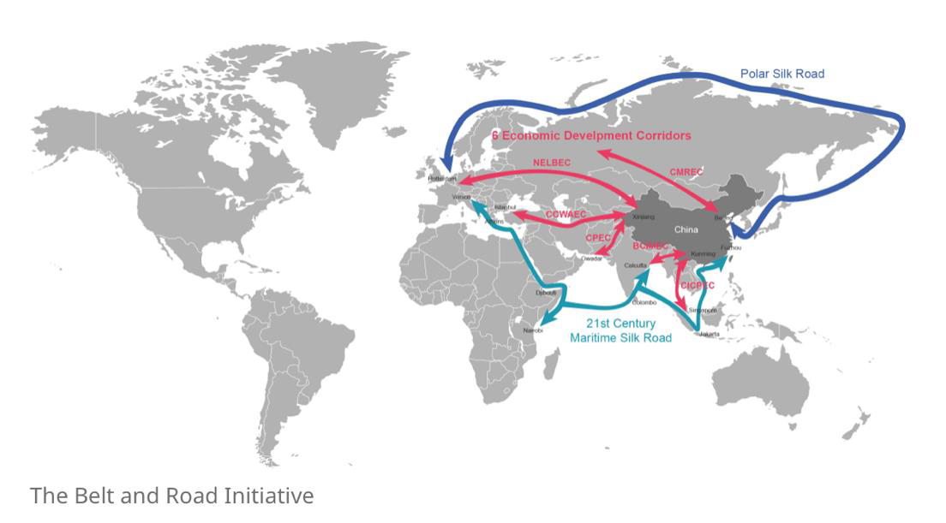

Slide 2
Examples of Recent Policies
Policies | Led by
Guidelines of Ecological Environment Protection for Overseas Investment and Cooperation Construction Projects (2022) | MEE & MOFCOM
Green Investment Principles for the Belt and Road Initiative (2019) | CBIRC
Guidance on Promoting Green Belt and Road (2017) | MEE, MFA, NDRC & MOFCOM
Belt and Road Ecological and Environmental Cooperation Plan (2017) | MEE
Administrative Measures for Enterprise Outbound Investment (order no. 20) | MOFCOM
Further Guiding and Regulating the Outbound Investment Direction (2017) | MFA, NDRC, PBOC & MOFCOM
Interim Measures for the Supervision and Administration of Overseas Investment of Central Enterprises (2017) | SASAC
Administrative Measure for the Verification, Approval and Record-Filing of Outbound Investment Projects (2014) | NDRC

Slide 3
THESE GUIDELINES LEGITIMIZE CIVIL SOCIETY ENGAGEMENT
Green Credit Guideline Article 21
Banking institutions shall strengthen the environmental and social risk management for overseas projects to which credit will be granted and make sure project sponsors abide by applicable laws and regulations on environmental protection, land, health, safety, etc. of the country or jurisdiction where the project is located. The banking institutions shall make promise in public that appropriate international practices or international norms will be followed as far as such overseas projects are concerned, so as to ensure alignment with good international practices.
Green Investment Principles for the Belt and Road
Principle 1: Embedding sustainability into corporate governance
Principle 2: Understanding Environmental, Social and Governance Risks
Principle 3: Disclosing environmental information
Principle 4: Enhancing communication with stakeholders
Principle 5: Utilizing green financial instruments
Principle 6: Adopting green supply chain management
Principle 7: Building capacity through collective action

Slide 4
NGOs’ Role in Green BRI
Policy Advocacy
SOEs HQ: Propel SOEs to Shift Business Strategy (industrial investor, EPC, equipment)
CBIRC/Banks: Strengthen Financial Regulator’s Oversight, Frameworks and Tools
Bridging
Transmitting perceptions of project/sector/country risks (financial, environmental, social, and governance)
Corporate/Project Monitoring
Challenge corporate actors’ credibility and social license to operate
International Leverage
Leveraging Corporate Access to Global Capital
Green investment diplomacy
NDRC/SASAC: Advocate for Industrial Policy Transition
MEE: Empower Risk Managers and Place more Checks-and-balances
Facilitating learning of green investment policy frameworks
Info. and knowledge sharing among organizations from China and host countries
Stakeholder dialogue (impacted community, local NGO, Chinese investor and contractor)
Alert to avoid/reduce Project-level Risks
Alternative demand and shift business investment strategies
Expanding International Norms (OECD, Central Banks/NGFS) and Upholding Green BRI commitments (Green Investment Principles)

